Slide 1
“Mobile Doctor” Project Presentation
Presented By
Nur-E-Alam Jony
ID:20141201039
Session:2014-15

Slide 2
About the project
It is a semester course project.
Course Code: CSE168
Course title: C Project
Supervised By :
Md. Saleh Ahmed
Assistant Professor & Chairman,
Dept. of Computer Science & Engineering,
Bangabandhu Sheikh Mujibur Rahman Science & Technology University.

Slide 3

Introduction
“Mobile Doctor” is a computer based project . There are user accounts . User can store his/her regular health data such as weight , sugar level,body temperature and blood pressure.It helps the user to aware about his/her body fitness . It also diagnose diseases. It is easy and cost free . Anyone can access .

Slide 4
Works with 1.Editor(Code::Blocks) 2.C Programming Language with graphics 3.Referenced websites- 1. www.labtestsonline.org 2. www.webmd.com 3. www.healthline.com 4. www.heart.org 5. www.BDdrugs.com 6. www.NHS.com 7. www.uptodate.com

Slide 5
Accessing it For accessing it, first user have to create an account.Then logging-in,user can store regular health data, diagnose diseases , can get tips etc.

Slide 6
Features of the project >Weight chart >Sugar level chart >Body temperature chart >Blood pressure chart >Diagnose >Drugs Index >Profile >Refreshment >Log out

Slide 7
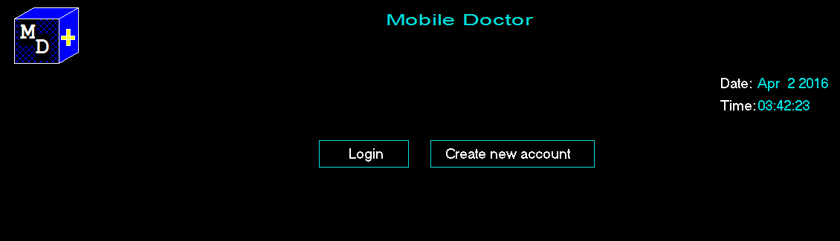
Log in
Click in log in option, the user who has account, can enter his/her own account.
Create new account
One can open a new account.

Slide 8
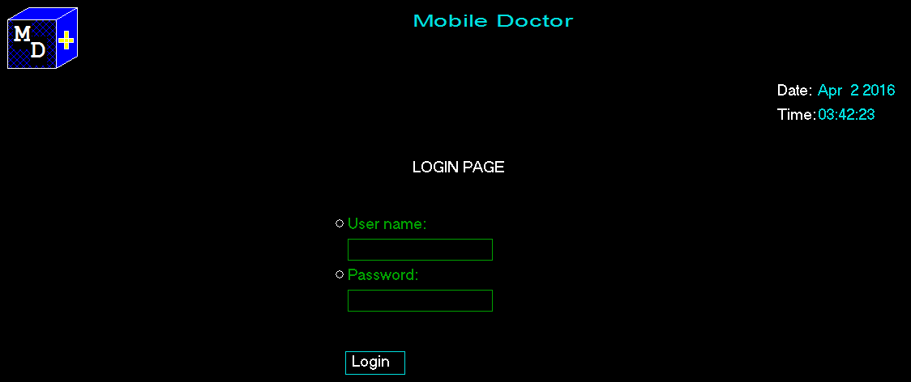
Log in Page By entering user name & password one can log in.

Slide 9
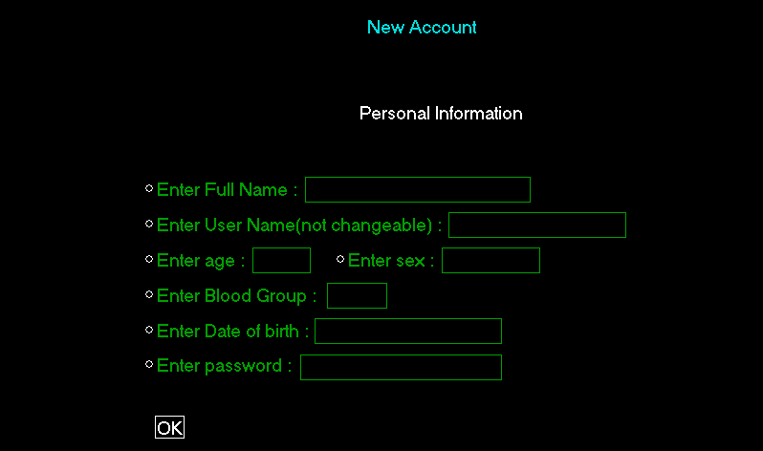
Create new account page Here personal information are given to create a new account.

Slide 10
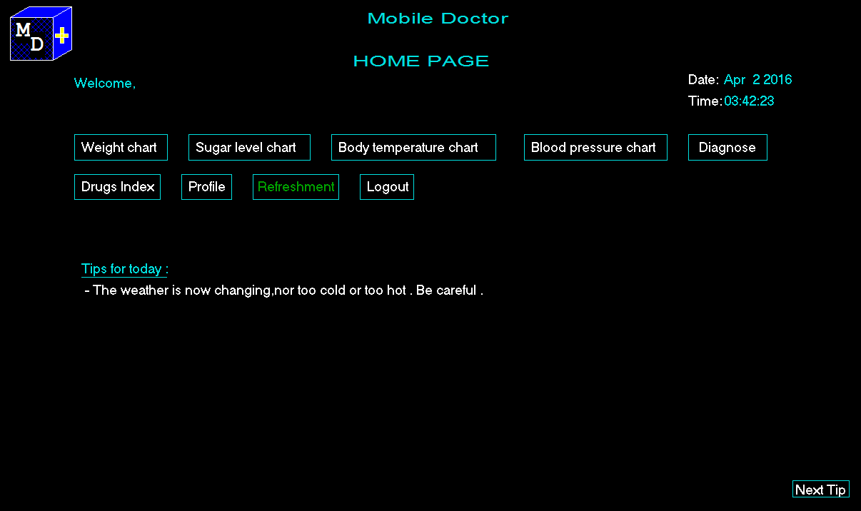
Home Page Here user gets all other options.

Slide 11
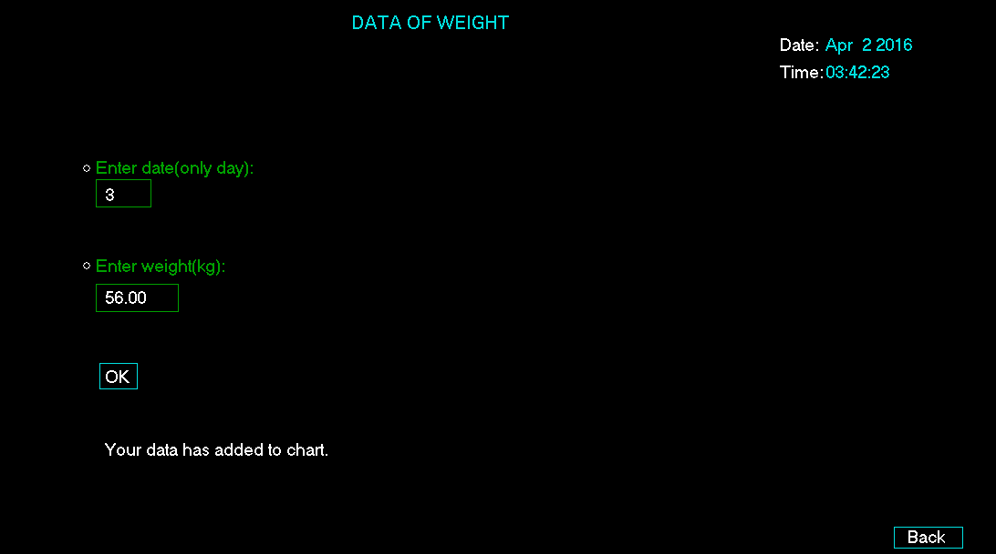
Adding data Here user can store daily weight data and able to see calender wise and graphically.

Slide 12
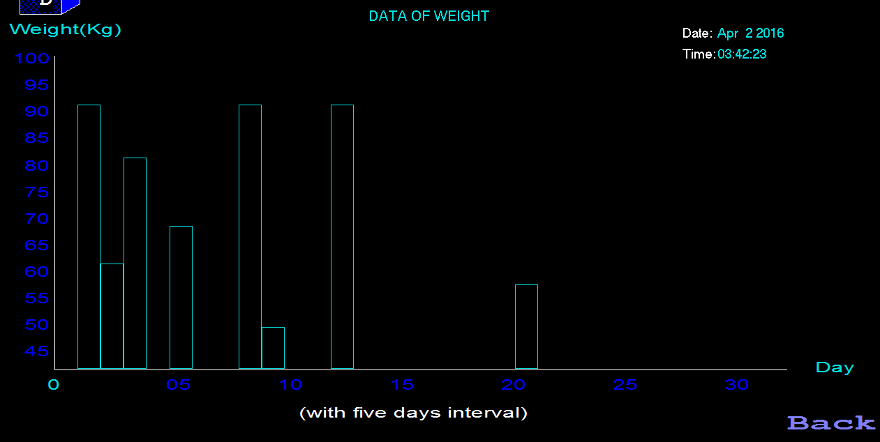
Graphical Representation

Slide 13
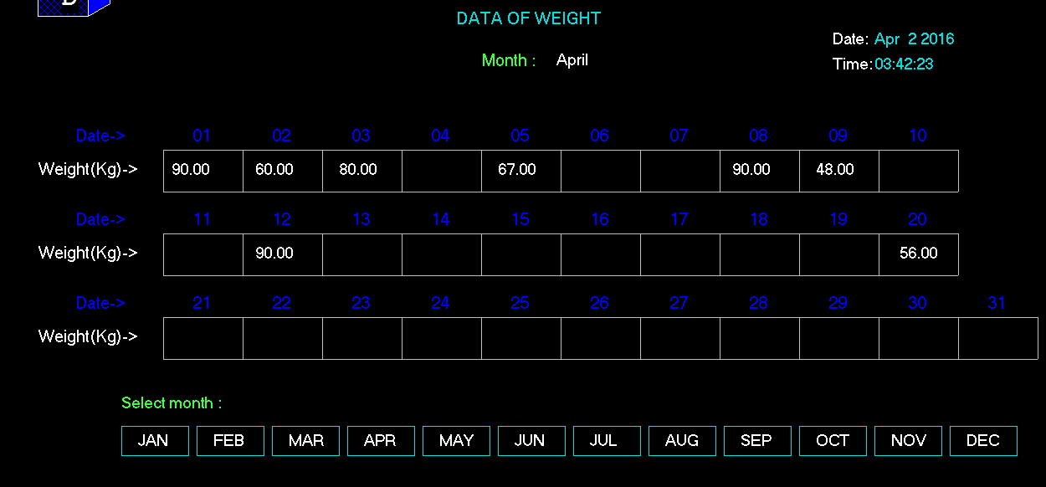
Calender wise representation

Slide 14
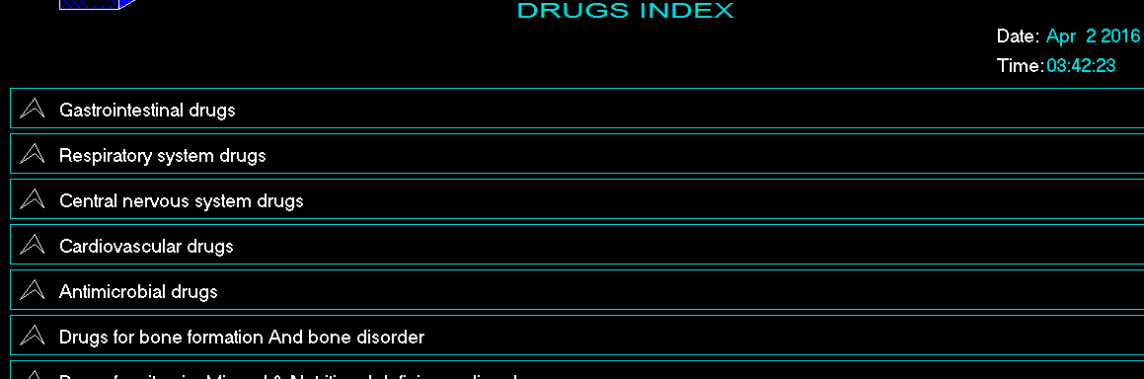
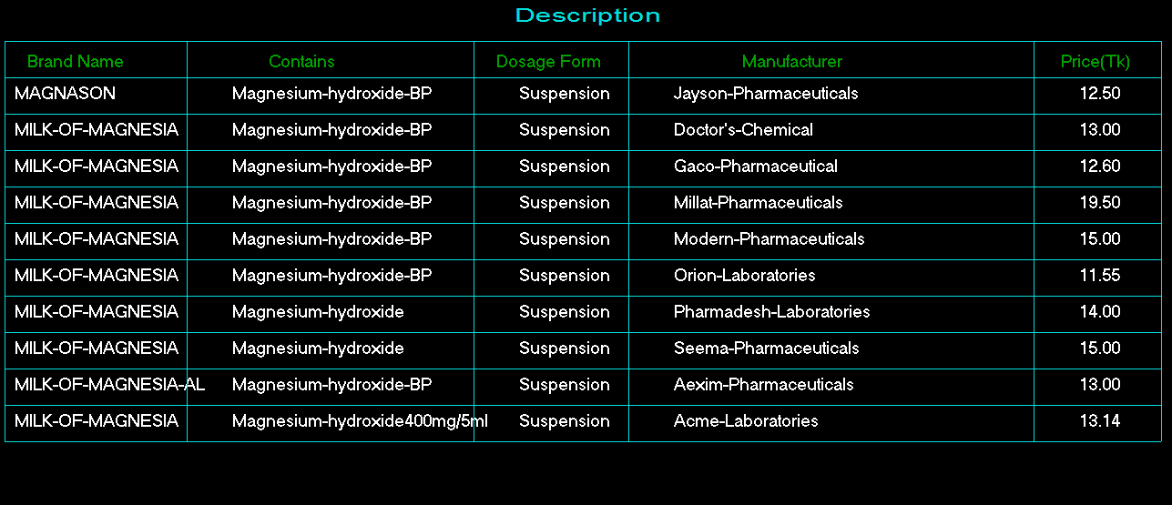
Drugs Index

Slide 15
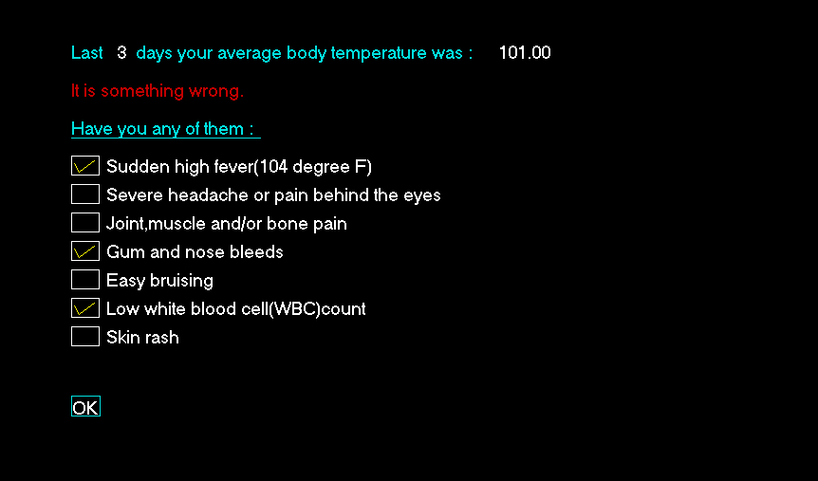
Diagnose

Slide 16
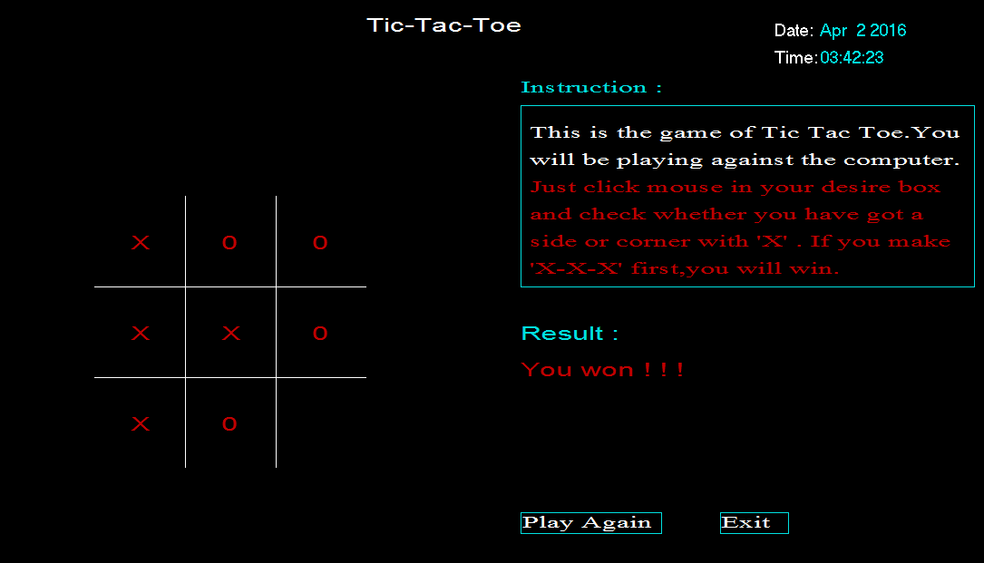
Refreshment

Slide 17
Implementation
1.When user open an account,there open four text documents.
Text documents are for keeping-
*Profile
*Weight
*Sugar level
*Temperature
2.The profile documents named with user name & password.So.in time of log in,user have to input correct name & password
3.When data input,it stores in the respective file.
4.Data are showing from distinct file when we want.

Slide 18
Limitations Diagnosing system is very sensetive.It varies from country to country,region to region,gender to gender,age to age.So,my assumptions are not more efficient.

Slide 19
Future Plan If I will work with doctors and work with various prescription data,this can be made more useful and efficient.

Slide 20
THANKS TO ALL.

